Slide 1
DOPP 2019W Exercise 3
Group 32
Eszter Katalin Bognar - 11931695
Luis Kolb - 01622731
Alexander Leitner - 01525882
Analysis of flows of refugees between countries

Slide 2
Objectives of the analysis
What is the most accurate overview of flows of refugees between countries that can be obtained?
Are there typical characteristics of refugee origin and destination countries?
Are there typical characteristics of large flows of refugees?
Can countries that will produce large numbers of refugees be predicted? Can refugee flows be predicted?

Slide 3
Data sources
OECD International Migration Database data (https://stats.oecd.org/Index.aspx?DataSetCode=MIG)
Gross Domestic Product per Capita data (https://data.worldbank.org/indicator/NY.GDP.PCAP.CD)
Human Development Index data (http://hdr.undp.org/en/data)
World Governance Index data (https://datacatalog.worldbank.org/dataset/worldwide-governance-indicators)

Slide 4
Data preprocessing
Each dataset were loaded and formatted including:
reshaping columns (changing rows to columns or columns to rows when necessary),
getting rid of unwanted columns,
renaming columns,
setting proper data types,
setting country-year multiindex to facilitate future data merge.

Slide 5
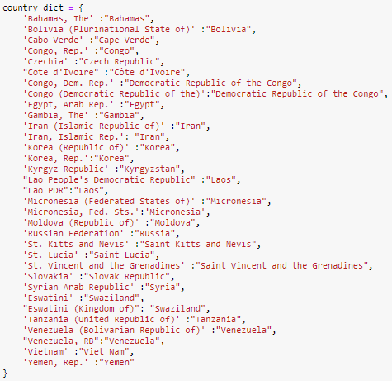
Resolving Country name inconsistency
We searched for different usage and typos in county names.
We selected oecd_df as base dataframe so we compare the country names in the oecd_df to the country names in the hdi_df, gdp_df, wgi_df datasets.
For making the country names consistent, we first tried out the fuzzy search method of the fuzzywuzzy library.
Due to errors, we finally decided to manually create a dictionary of country names to replace or delete them.

Slide 6
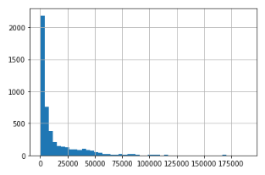
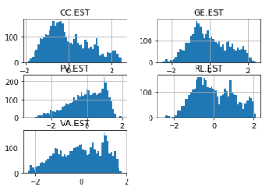
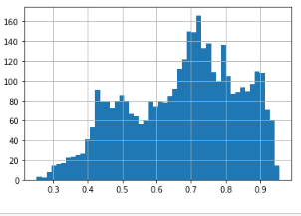
Outlier detection
We checked the distribution of hdi, wgi and gdp data showing there are more poor than wealthy countries...We can not see any outliers. GDP is skewed towards zero, HDI is in the range of [0-1], wgi metrics are in the range of [-3-3].

Slide 7
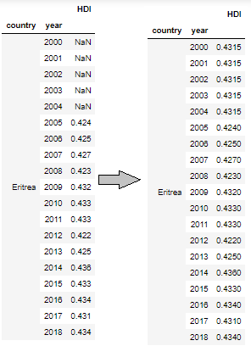
Missing value handling
Missing values in the hgi, gdp and wgi data
Since the hdi, gdp and wgi indicators can be treated equally and the values don't change rapidly from year to year we replace the missing data with the median of the data for the given country pairs.
We selected this method because interpolation can't work properly where there are many missing values one after another. Where there weren't any data available for the given country pairs, we simply dropped the rows.

Slide 8
Missing value handling
Missing values in the oecd dataset
There are a number of country pairs (e.g. Albania-Chile) where none of the years have inflows of asylum seekers between countries. Since we could not find any similar data source where there was appropriate data available for cold deck imputation. We assume that migration is not considerable between these countries and we decided to delete these rows from the final dataset.
For the remaining missing values, we calculated the median of asylum_seekers for the given country pairs and filled the holes with this value.

Slide 9
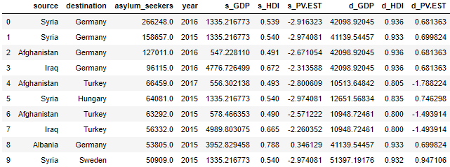
Final dataset validation
We can see that the most remarkable refugee inflow was in 2015-2017 from Syria, Afghanistan, Iraq and Albania and Serbia to Germany, Turkey and Hungary. This coincide with the recent news about massive influx of refugees from the Middle East to Europe through the Balkan route.
We can see that the HDI and GDP indexes are very low of the refugee producer countries and also the Political Stability and Absence of Violence/Terrorism indicator shows problems.
Destination countries usually have higher gdp, hdi values and more political stability.
We can see that our dataset is comprehensive and good source for further analysis.

Slide 10
Correlation between refugees and Indicators
Are there typical characteristics of refugee origin and destination countries?
Are there typical characteristics of large flows of refugees?

Slide 11
Are there typical characteristics of refugee origin and destination countries?
The World Governance Indicators of origin countries negatively correlate with the number of asylum seekers originating from there - when some Indicators decrease, the number of refugees originating from that country tends to increase. Important to notice, HDI and GDP have no correlation with the number of refugees fleeing a country or choosing a country to flee to.

Slide 12
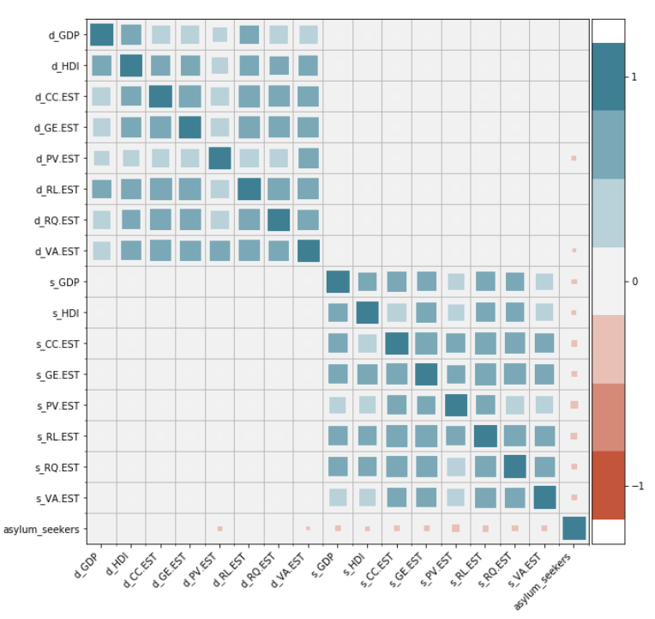

Slide 13
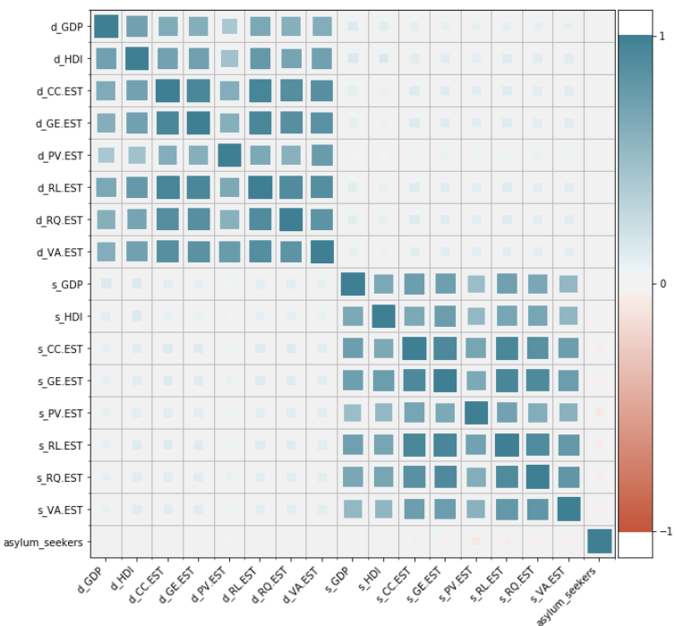

Slide 14
Are there typical characteristics of large flows of refugees?
Typically, large flows of refugees originate from countries with rather negative Indicators from the WGI, as well as lower HDI and GDP. Destination countries typically register a much higher GDP and HDI, as well as much better/higher Indicators from the WGI.
Again, historical, geographical and cultural events and aspects play a huge part.

Slide 15
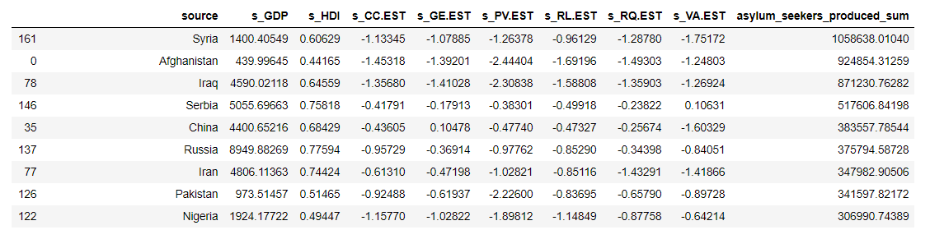
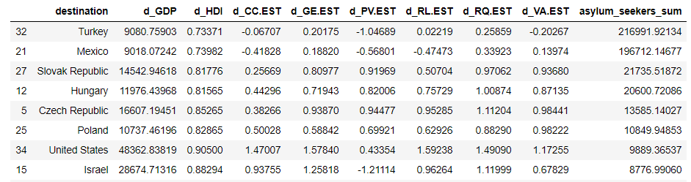

Slide 16
Can countries that will produce large numbers of refugees be predicted?
First we look for the countries which produce the largest number of refugees
Then use Lasso regression to predict the data from 2017 (based) on 2000-2016

Slide 17

Results of the prediction

Slide 18
Can refugee flows be predicted?
Difficult to answer
suddenly WAR!
environmental disasters (volcanic eruptions, drought…..)

